Slide 1
Getting Started With Kubernetes
CheeeCagGo VMUG UserCon
Timmy Carr @timmycarr
Staff Cloud Native Field Engineer – Kubernetes Practice
October 24th, 2019

Slide 2
Current state
Kubernetes
Tools to Get Started

Slide 3
Current State

Slide 4
Microservices
Moving forward from the typical monolith…
Split applications into smaller services.
Allow teams to specialize in deploying and making their service available.
Allow experimentation – Teams can choose how to code/deploy their service.

Slide 5
All of This Requires…
better tooling.
Machinery that understands how to tie all of these components together.
Things like:
Replica management
Service discovery
Network access control for services
Health checking

Slide 6
Kubernetes Overview
***Much of this section leverages diagrams from Joe Beda’s Kubernetes 101 Presentation***
https://github.com/jbeda/slides-kubernetes-101

Slide 7
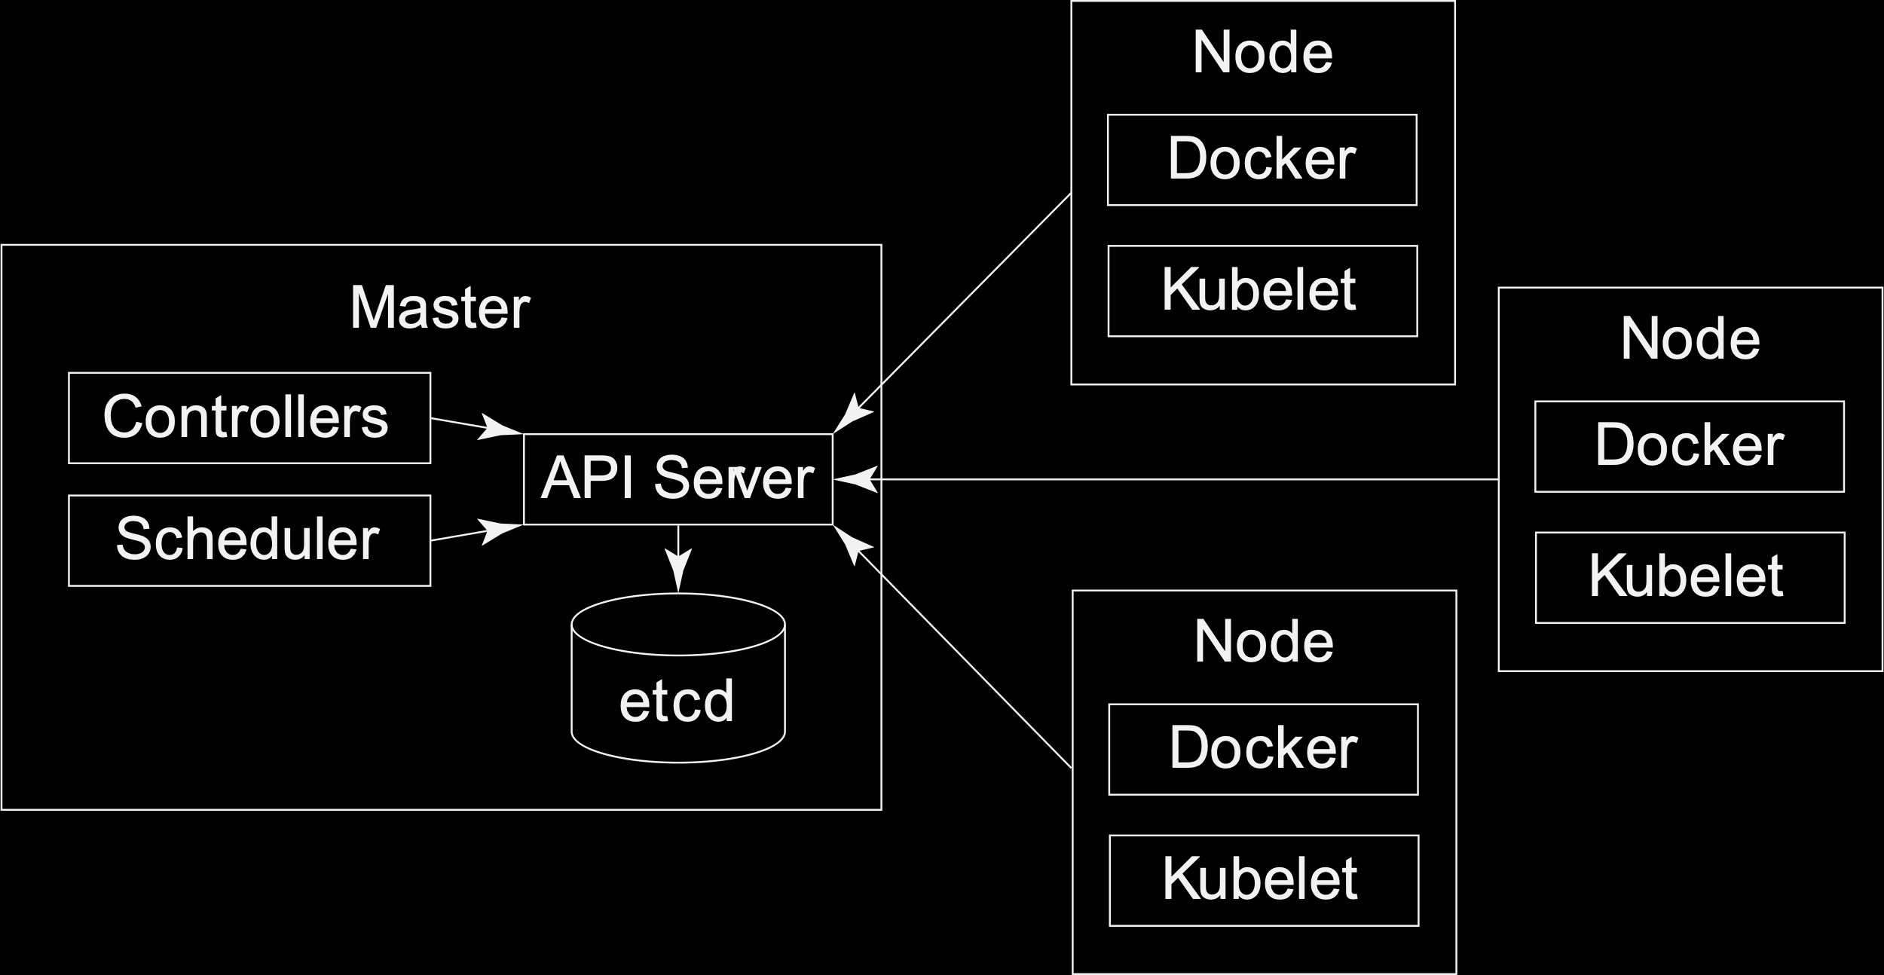
A Kubernetes Cluster
the high level cluster components

Slide 8
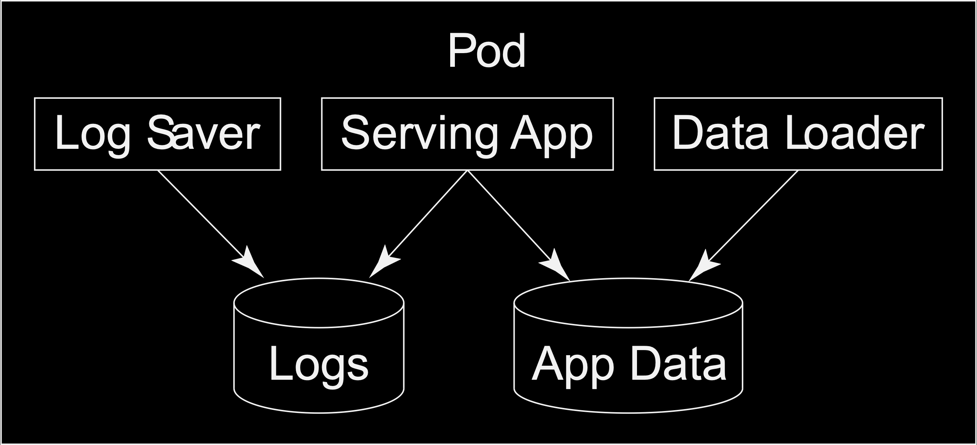
The Pod
the atomic unit in Kubernetes

Slide 9
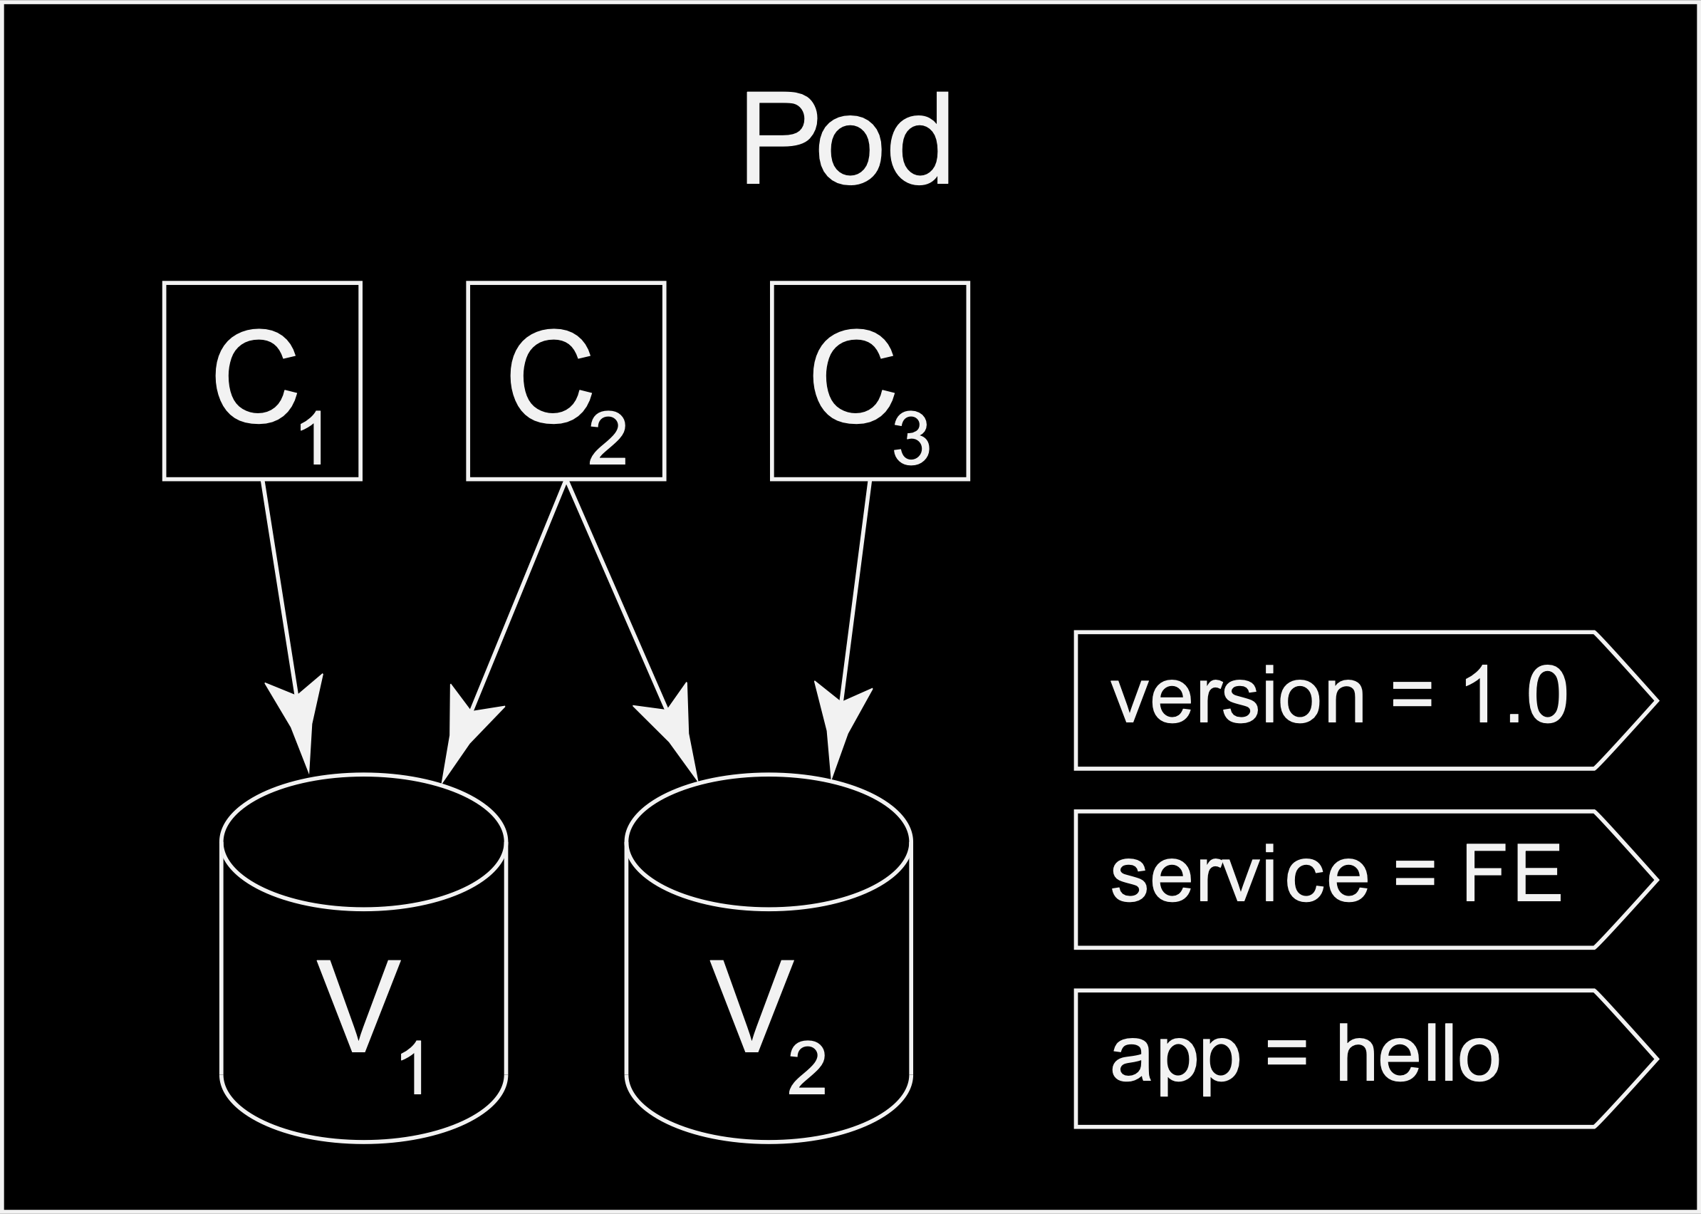
Labels
allow us to tie components within Kubernetes together

Slide 10
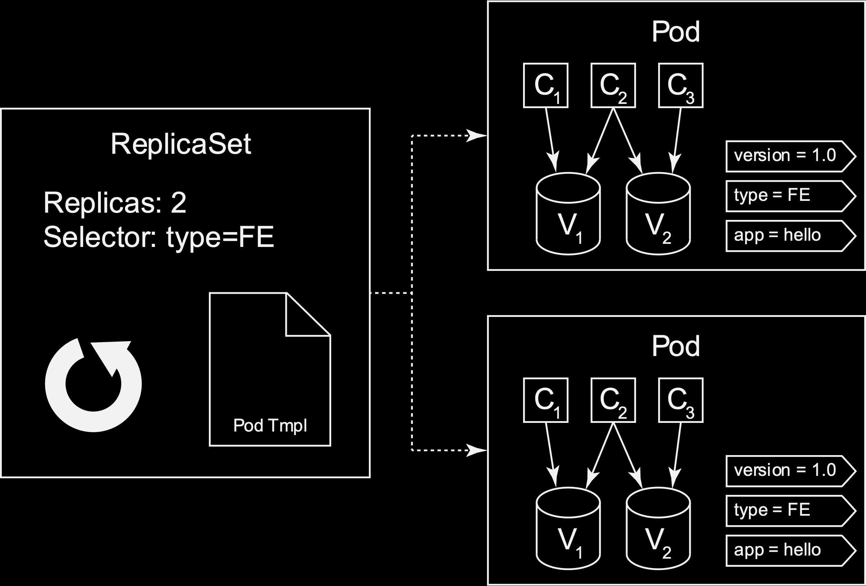
ReplicaSets
help to make sure that multiple copies of a pod is running.

Slide 11
Deployments
declarative orchestration of application roll-out
Deployment

Slide 12
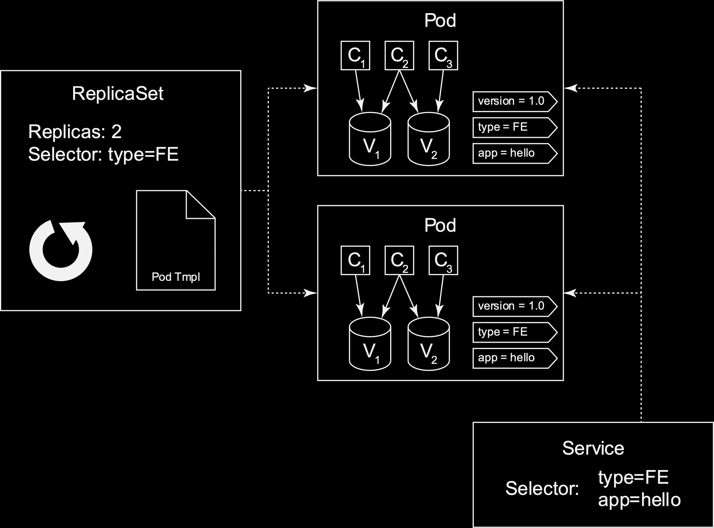
Services
exposing pods based on label
Deployment

Slide 13
And SO Much More…
We’ve just scratched the surface here. More items that we’ve not covered:
Namespaces
Isolated workspaces for users/projects
Ingress
L7 load balancing
Deployments
Declarative version updates
Jobs
Run to completion
Autoscaling
Automatically adjust replica count
DaemonSets
Run something on every node (or subset)

Slide 14
Tools to Get Going

Slide 15
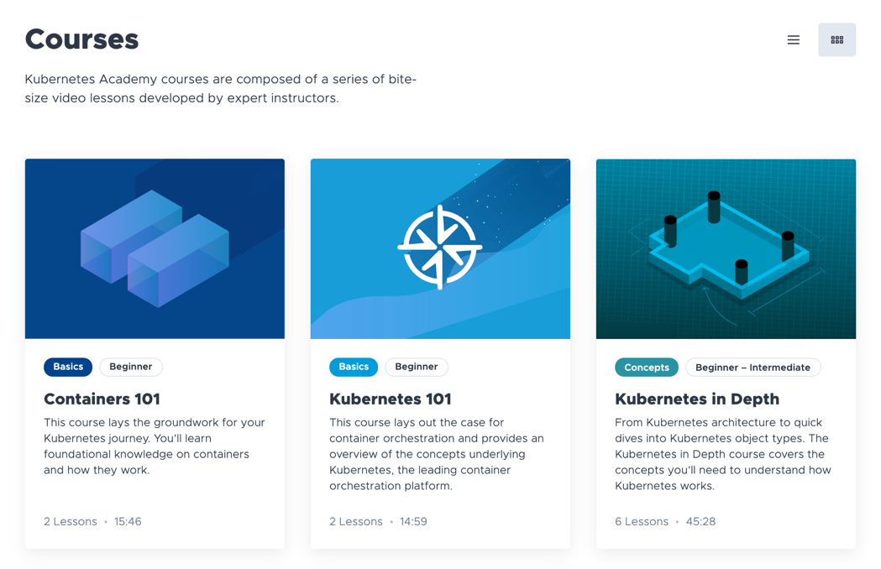
Step 1 - Free VMware Kubernetes Training
Multiple courses for each level of of need.
Containers 101
Kubernetes 101
Kubernetes in Depth
Kubernetes Cluster Operations
CKA Exam Preparation
https://kube.academy

Slide 16
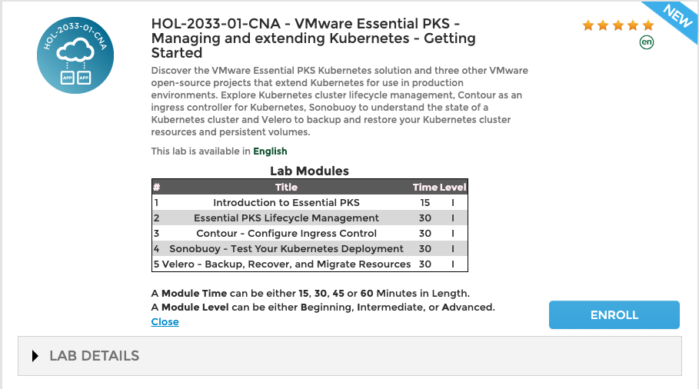
FREE VMware HOL
Try out our VMware PKS Hands On Lab
Learn about the features of VMware Enterprise PKS
- https://labs.hol.vmware.com

Slide 17
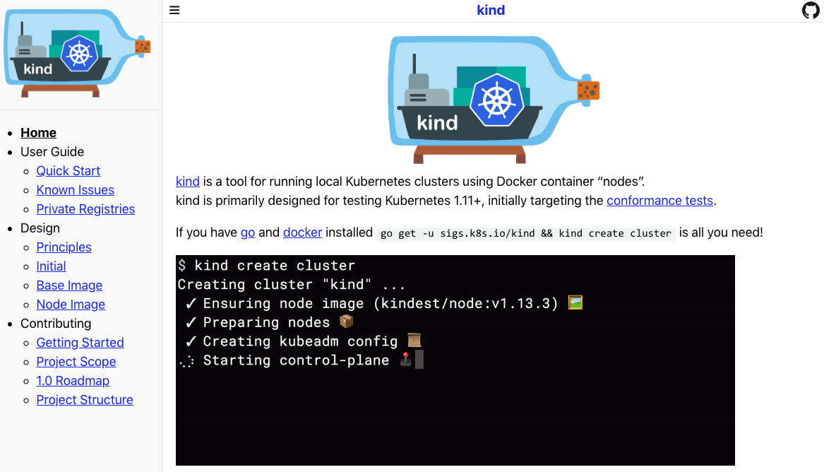
Locally – Use kind
The Kubernetes in Docker Project – https://kind.sigs.k8s.io
kind is now being integrated into the upstream testing platform for Kubernetes – it’ll work really well for you too!
Use kind to get a simple cluster up and running on your laptop with Docker:

Slide 18
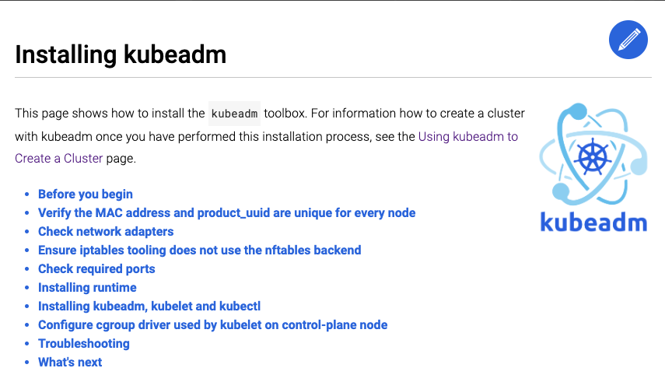
Hands On - Kubernetes Installs with kubeadm
Purpose built tool built to provide a fast path for creating Kubernetes clusters.
Only deals with bootstrapping Kubernetes and not provisioning or configuring machines.
https://github.com/kubernetes/kubeadm

Slide 19
Hands On - Cluster API and CAPV
Build your own Kubernetes Cluster on vSphere
Kubernetes is complicated – use a pre-packaged solution that does this for you.
We recommend Cluster API for installation of kubernetes.
CAPV is the vSphere Provider for Cluster API (CAPI) and leverages kubeadm

Slide 20
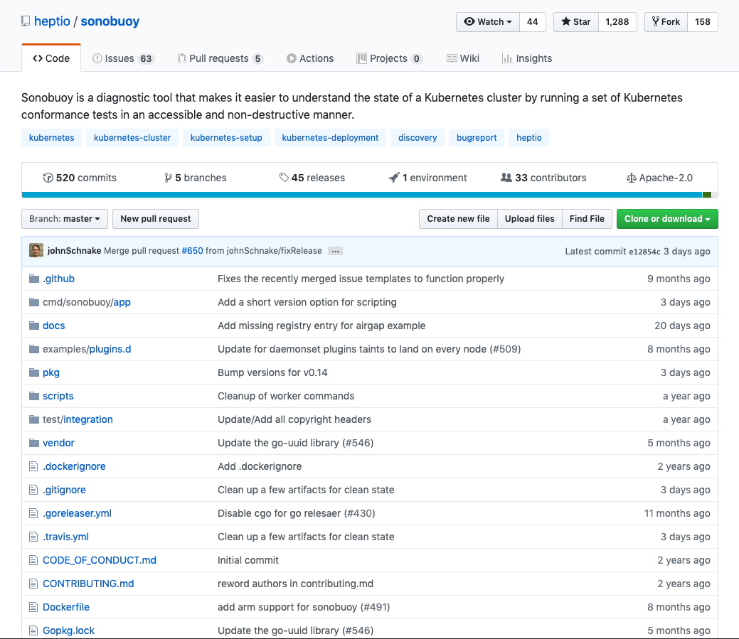
Make Sure Your Cluster Passes Muster!
Use Sonobuoy - https://github.com/heptio/sonobuoy

Slide 21
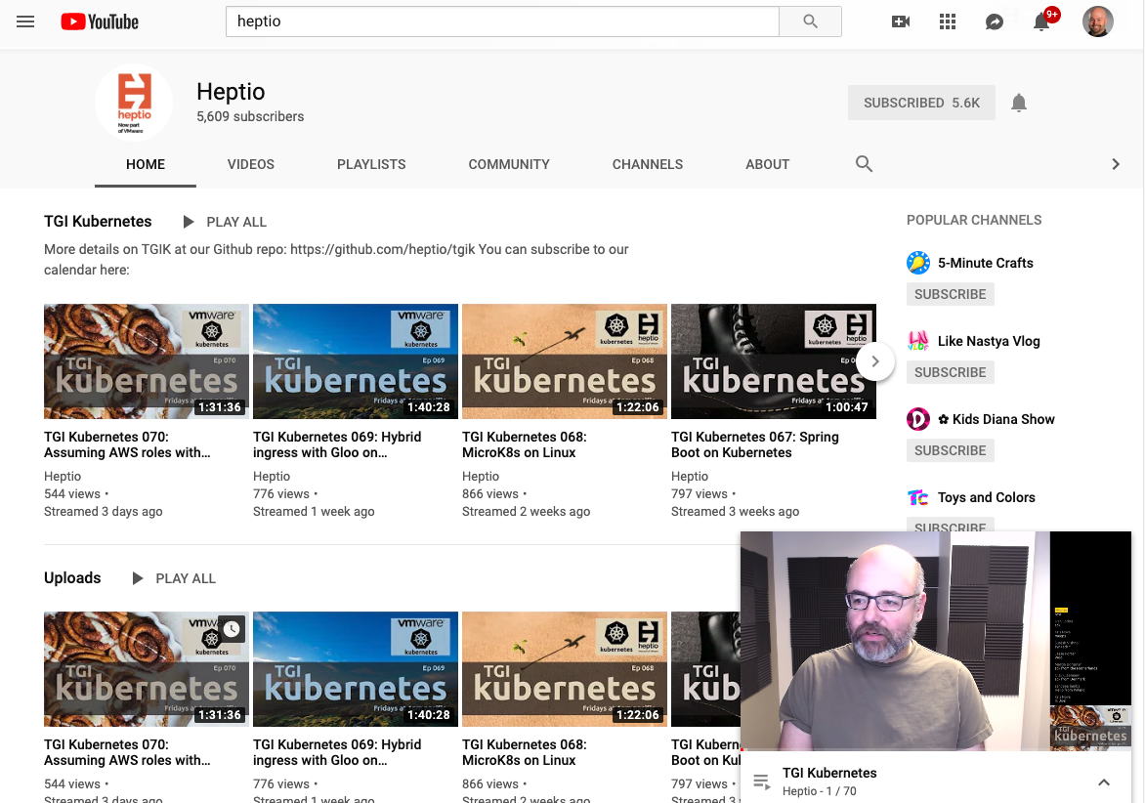
Community Help!
Where to get more info without a class.
Kubernetes Slack – slack.k8s.io for an invite
TGI Kubernetes – weekly YouTube stream.
Kubernetes docs
https://kubernetes.io/docs/tutorials/

Slide 22
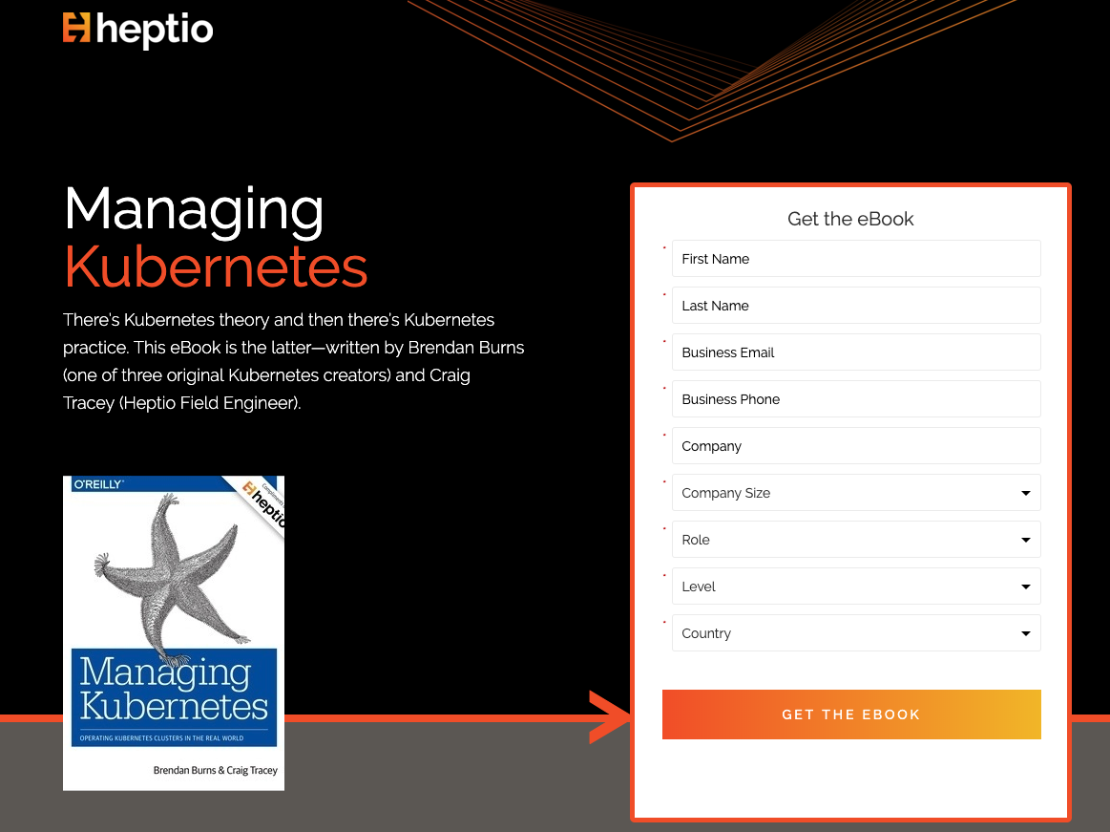
Get Your Copy of Managing Kubernetes
Use the Google, ”Heptio Managing Kubernetes”

Slide 23
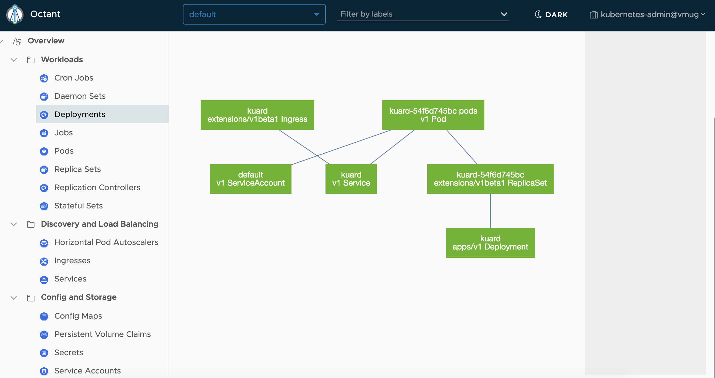
Use Octant for Visibility
Kubernetes insight for everyone! www.github.io/vmware-tanzu/ocatant

